Slide 1


FULL STACK WEB DEVELOPMENT WITH JAVA
( the backend part)
Lecture-1

Slide 2
Pre-Requisites
To start learning JEE or Java Back End we must be familiar with:
Inheritance and Polymorphism , specially interfaces and abstract classes
Exception Handling
JDBC and Collections
No knowledge of Java GUI is required.
No knowledge of Multi-Threading is required
No knowledge of File Handling is required

Slide 3
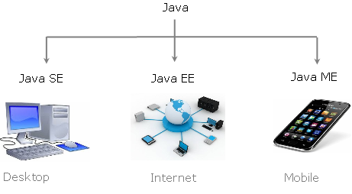
Java Platforms

Slide 4
What Is JEE/ Java Back End/Adv Java ?
JEE used to stand for Java Enterprise Edition but now it has been renamed to Jakarta Enterprise Edition
It is a Java based platform used for developing secure and scalable enterprise/web applications.

Slide 5
What Is A Web Application ?
A web application which we usually refer to as website , is a collection of web pages .
In technical terms , a web application (Web app) is a program that is stored on a server , executed on the server but it’s output is delivered through the Internet to a browser.

Slide 6
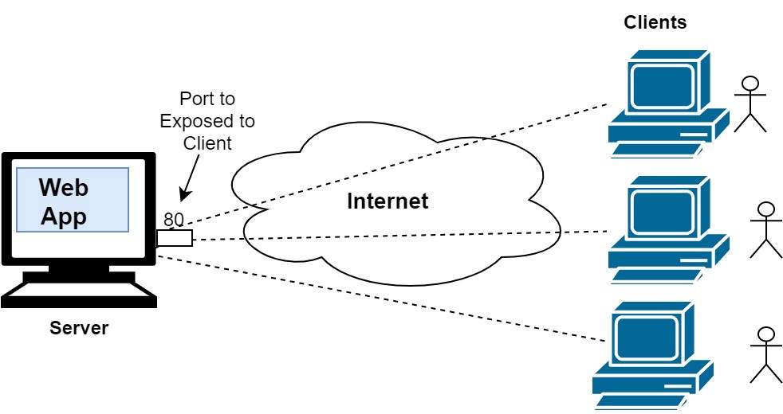
What Is A Web Application ?

Slide 7
Layers In A Web Application
Typically, a multi-tiered application has three layers:
a client tier
a middle tier
a data tier
popularly called Front End
popularly called Back End

Slide 8
Role Of Three Tiers
The client tier consists of the UI that makes the requests to the middle tier.
The middle tier contains business logic / functions to handle client requests and process the application data, storing it in a permanent datastore in the data tier.
The data tier represents the data storage area of the application and is mainly managed by RDBMS like Oracle,MySQL etc

Slide 9
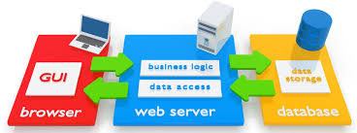
Interlinking Of Three Tiers

Slide 10
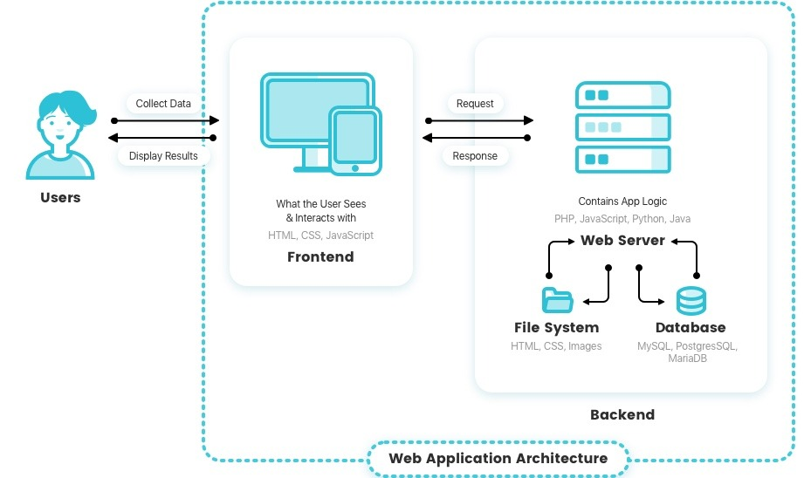
Interlinking Of Three Tiers

Slide 11
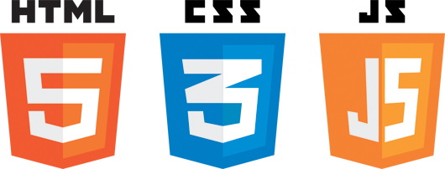
Languages Used In Front End

Slide 12
Role Of Three Languages
In short we can remember that:
HTML is for content
CSS is for presentation
JavaScript is for behaviour

Slide 13
What Is Back End ?
Back-end development refers to the server-side development.
It is the term used for the behind-the-scenes activities that happen when performing any action on a web application.
Backend developer focuses on databases, business logic, and the architecture of web application.

Slide 14
What Is Back End ?
Think for a minute, what happens when you fill your username and password in Gmail’s login page.
All the data you filled goes to the gmail server
At the server , there is some piece of code which receives this data , performs a search query on the database and retrieves the result.
Based on the result of the query , it sends the response login accepted or login failed to the browser.
And the browser displays this result to you.

Slide 15
What Is A Web Server ?
We know that a web application runs on the internet and receives a huge number of requests from clients (browser) round the clock.
For example, Google receives over 63,000 searches per second, 3.8 million searches per minute and 5.6 billion searches per day.
So there must be a piece of software present to receive these requests and properly handle them.
This software is a Web Server.

Slide 16
What Is A Web Server ?
Thus a Web Server is a program that runs on the server machine and :
remains connected to the internet 24*7
receives the request for a web application from the client
passes this request to the appropriate web application
executes the web application
receives back the response and
sends back this response to the client

Slide 17
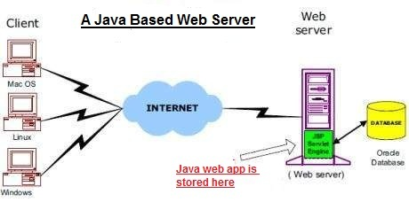
What Is A Web Server ?

Slide 18
Some Popular Java Based Servers
There are many Java based servers , but the most popular of them are:
Apache Tomcat
Glassfish
Weblogic
WebSphere
JBoss
We will be using Apache Tomcat in this course

